Slide 1
HEXAPAWN
APPLICATIONS OF AI AND MACHINE LEARNING

Slide 2
Agenda Style
Acknowledgement
We are thankful for the help and cooperation of the school authorities, our computer science teacher, Mrs. Manjula and Mrs. Uzma Fathima, for the successful completion of our investigatory project, “Hexapawn AI”
Hexapawn AI

Slide 3
Agenda Style
Certificate
This is to certify that the Computer Science practical project “Hexapawn AI” is submitted by “Tanay Patil”, “Sriram”, “Raunak Battu” of class XII-C appearing for the Computer Science practical exam of the Central Board of Secondary Education 2019-20.
Hexapawn AI

Slide 4
Definition of Machine Learning
Table of Contents
01
What is Hexapawn?
02
Flow Chart, Design, Output
03
Conclusion, Bibliography
04

Slide 5
What Is Machine Learning?
Machine learning is a study of computer algorithms that improve automatically through experience. It is seen as a subset of artificial intelligence, but she is running out of them to build a mathematical model based on sample data understanding data in order to make predictions are decisions without being explicitly programmed to do so.
01
03
Programming a computer to optimize standards, by using experience
Calculation of algorithms allow computers to develop behaviors based on real data
02
Machine Learning is a branch of Artificial Intelligence
You can simply impress your audience and add a unique zing.

Slide 6
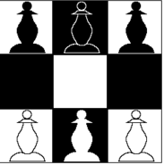
Hexapawn
Hexapawn is a deterministic two-player game invented by Martin Gardner. It is played on a rectangular board of variable size, for example at 3x3 board or on a chessboard. On a board of size 3x3, each player begins with three pawns, one for each square in the row closest to them. The goal of each player is to advance their pawns to the opposite end of the board or to prevent the other player from moving.
Hexapawn also happens to be one of the simplest demonstrations and applications of Machine Learning

Slide 7
Purpose
This may not be the first machine learning algorithm, there is Turing’s machine and there may be a lot of others. But we can for sure say that this is learning, our “computer” gets better every time.
Till now, we punished our computer when it makes a mistake, right? But what if we give it a reward for every good move? With punishing out “computer” whenever it makes a mistake, we increase the probability that the computer’s move each round leads to it success.
Hexapawn was designed to illustrate
mechanical game-players by Martin
Gardner, the well-known Scientific
American mathematics columnist.
But what if we reward it for every good move? If we reward computer for every good move, it makes that would reduce the probability of a losing marble appearing by increasing the probability of a matchbox generating a winning marble. The computer would eventually still reach perfect play because I’ll still remove the losing marbles.

Slide 8
How does the game work?
As in chess, each pawn may be
moved in two different ways: it may be moved one square forward, or it may capture a pawn one square diagonally ahead of it.
A pawn may not be moved forward if there is a pawn in the next square.
Unlike chess, the first move of a pawn may not advance it by two spaces.
A player loses if he/she has no legal moves or the other player reaches the end of the board with a pawn.

Slide 9
System Requirements
Required
Python Modules
Operating System with a built-in/external Python Interpreter
Tkinter
Random
Copy
Time
Python IDEs and Code Editors
Platform Developed on
Python IDLE
Visual Studio Code
Anaconda
PyCharm
Windows

Slide 10
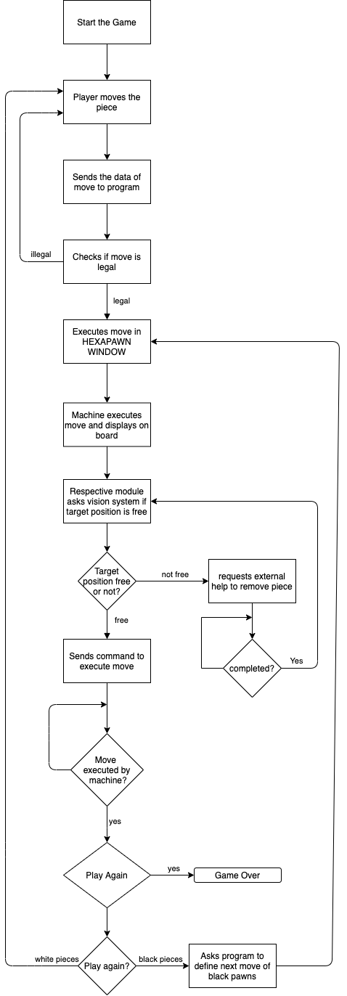
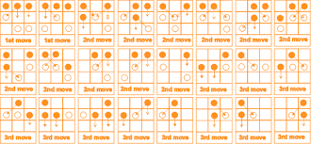
Flow Chart and Design
Basic functioning of the program
Possible outcomes of the game

Slide 11


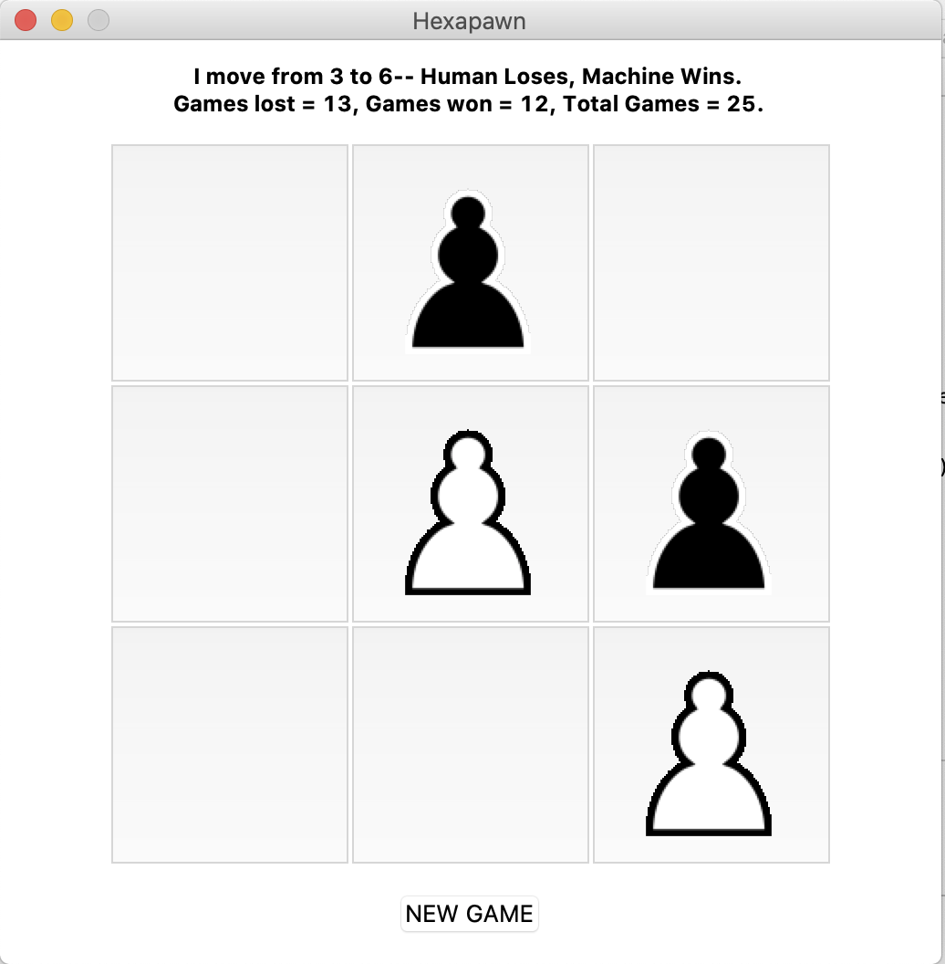
Output
Output after playing game 25 times
Black Pawn
White Pawn

Slide 12
Devices Used

Slide 13

Python Libraries Used
Copy
Assignment statements in Python do not copy objects, they create bindings between a target and an object. For collections that are mutable or contain mutable items, a copy is sometimes needed so one can change one copy without changing the other. This module provides generic shallow and deep copy operation.
Tkinter
The tkinter package (“Tk interface”) is the standard Python interface to the Tk GUI toolkit. Both Tk & tkinter are available on most Unix platforms, as well as on Windows systems. (Tk itself is not part of Python; it is maintained at ActiveState.)
Random
Functions in the random module depend on a pseudo-random number generator function random(), which generates a random float number between 0.0 and 1.0. random. random(): Generates a random float number between 0.0 to 1.0. The function doesn't need any arguments.

Slide 14
What is a ‘sprite’?
It’s a small graphics pixmap image
It’s normally stored in off-screen VRAM
It’s ready to be copied to on-screen VRAM
The copying operation is called a ‘BitBlt’
Several sprites can support an animation
Let’s see how to create a sprite array, then synchronize BitBlts with Vertical Retrace

Slide 15
Future Possible Improvements
Arrange your sprites in an array
Write an animation loop
Incorporate movement in sprite’s location
Study the source-code for higher efficiency.
Let user control direction with arrow-keys
Store your arrays in offscreen VRAM
Use modules such as TURTLE to improve the user interface and better animations.
Use Pyautogui to run computer vs computer simulations.

Slide 16
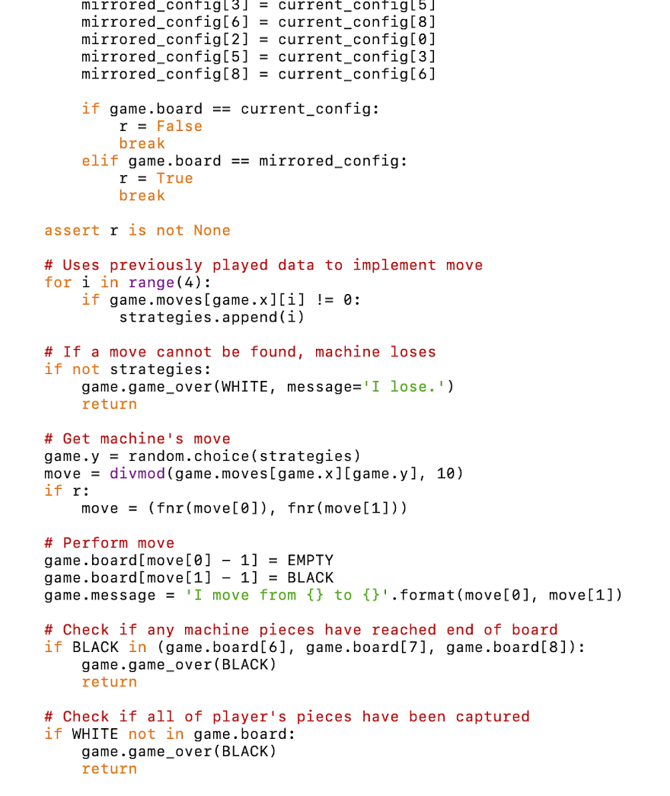
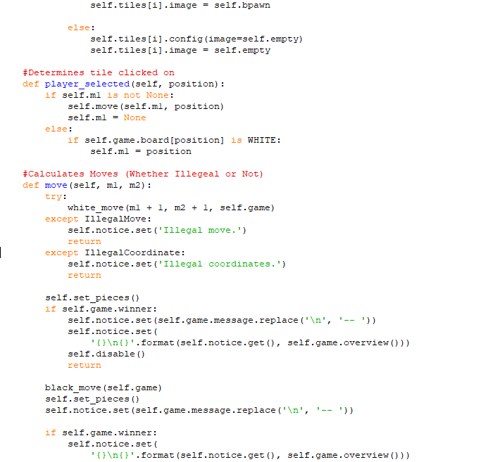
Source Code
The source code of this program was written in its entirety from scratch by Tanay Patil with help from his team members Sriram and Raunak.

Slide 17
Our Team Layout
Specialization - AI
Artificial intelligence (AI), sometimes called machine intelligence, is intelligence demonstrated by machines, unlike the natural intelligence displayed by humans and animals. Leading AI textbooks define the field as the study of "intelligent agents": any device that perceives its environment and takes actions that maximize its chance of successfully achieving its goals. Colloquially, the term "artificial intelligence" is often used to describe machines (or computers) that mimic "cognitive" functions that humans associate with the human mind, such as "learning" and "problem solving".
Tanay Patil
Sriram
Programmer
Programmer
Raunak Ramesh Battu
Programmer

Slide 18
Agenda Style
Conclusion
Bibliography
https://www.youtube.com/watch?v=sz7UAZNgGg8
http://cs.williams.edu/~freund/cs136-073/GardnerHexapawn.pdf
http://www.mscroggs.co.uk/menace/
https://prezi.com/paoljqexnos3/hexapawn/?frame=daa6ec7c35d48ab6ef1fd5e61aa0ba380e9d1400
http://www.mscroggs.co.uk/blog/19
Our Hexapawn Machine uses reinforcement learning to figure out what is the best action to take in any given state. In principle, during the learning process we “punish” the machine each time it makes a mistake by taking the set of moves away from him, making him less likely to make a mistake. Another possible solution would be to reward the machine whenever it makes a good play by pushing forward the used set of moves, making him more likely to choose the action that won before.
Hexapawn AI

Slide 19
Thank you
Any Questions?
To download the source-code, visit– github.com/Dpsnorth/Hexapawn

